Slide 1


IMDb Movie Multi-Label Genre Classifier
IMDb Movie Multi-Label Genre Classifier
COM3029 – Natural Language Processing
Group 10
Tom Wilson
Kuan Hao Chen (Roger)
Lavinia-Iulia Fratila
Alexandros Constantinou (Alex)

Slide 2
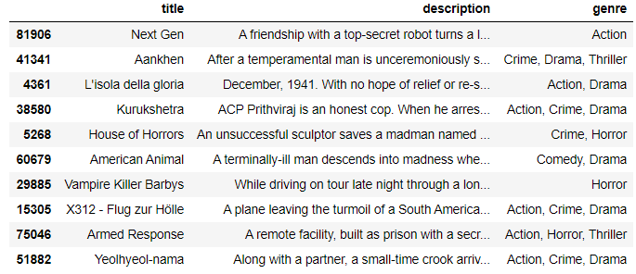
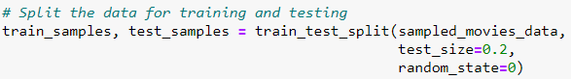
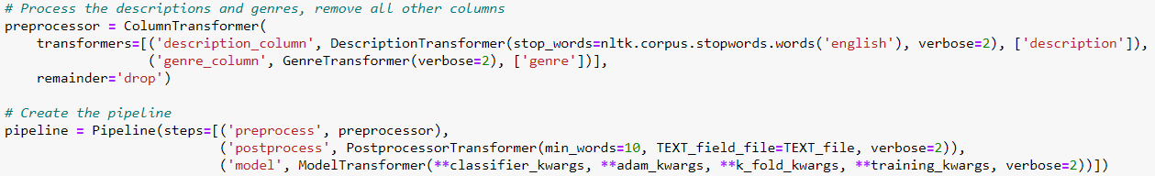
Pipeline
Before training a new classifier, the dataset is sampled and split into training and testing sets.
The pipeline is then created, and the steps determined by calling custom transformer classes.
Group 10 - Tom

Slide 3
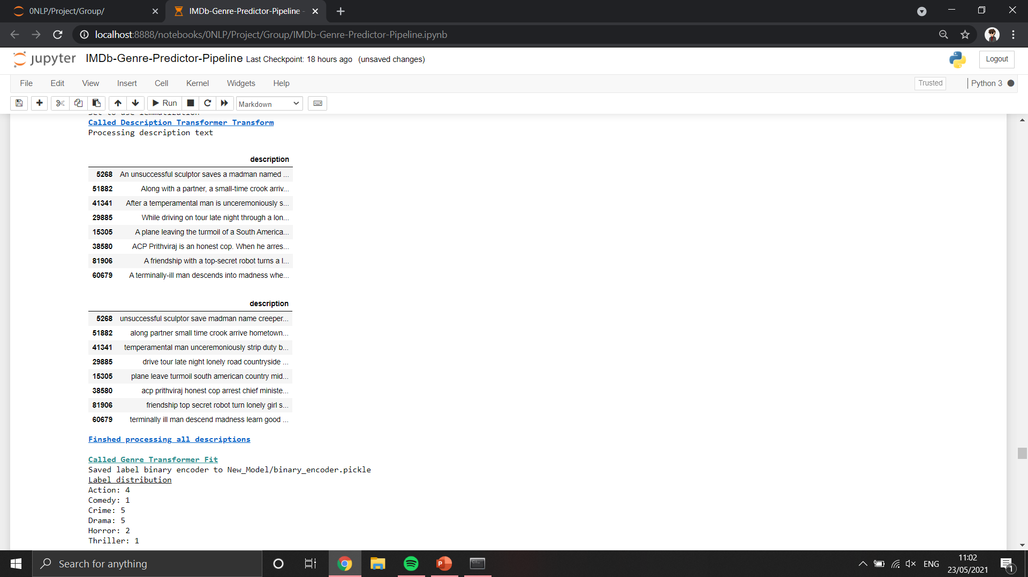
Column Transformer
The column transformer consists of two steps for processing the columns of the train / test sets:
1) The description transformer processes the text of the description column
Punctuation and bad characters are removed
Accented characters are converted to non-accented form, for example “Léon” → “Leon”
Stop words are removed with the NLTK stop word list
Lemmatization is applied to convert words into a form compatible with GloVe word embeddings
Group 10 - Tom

Slide 4
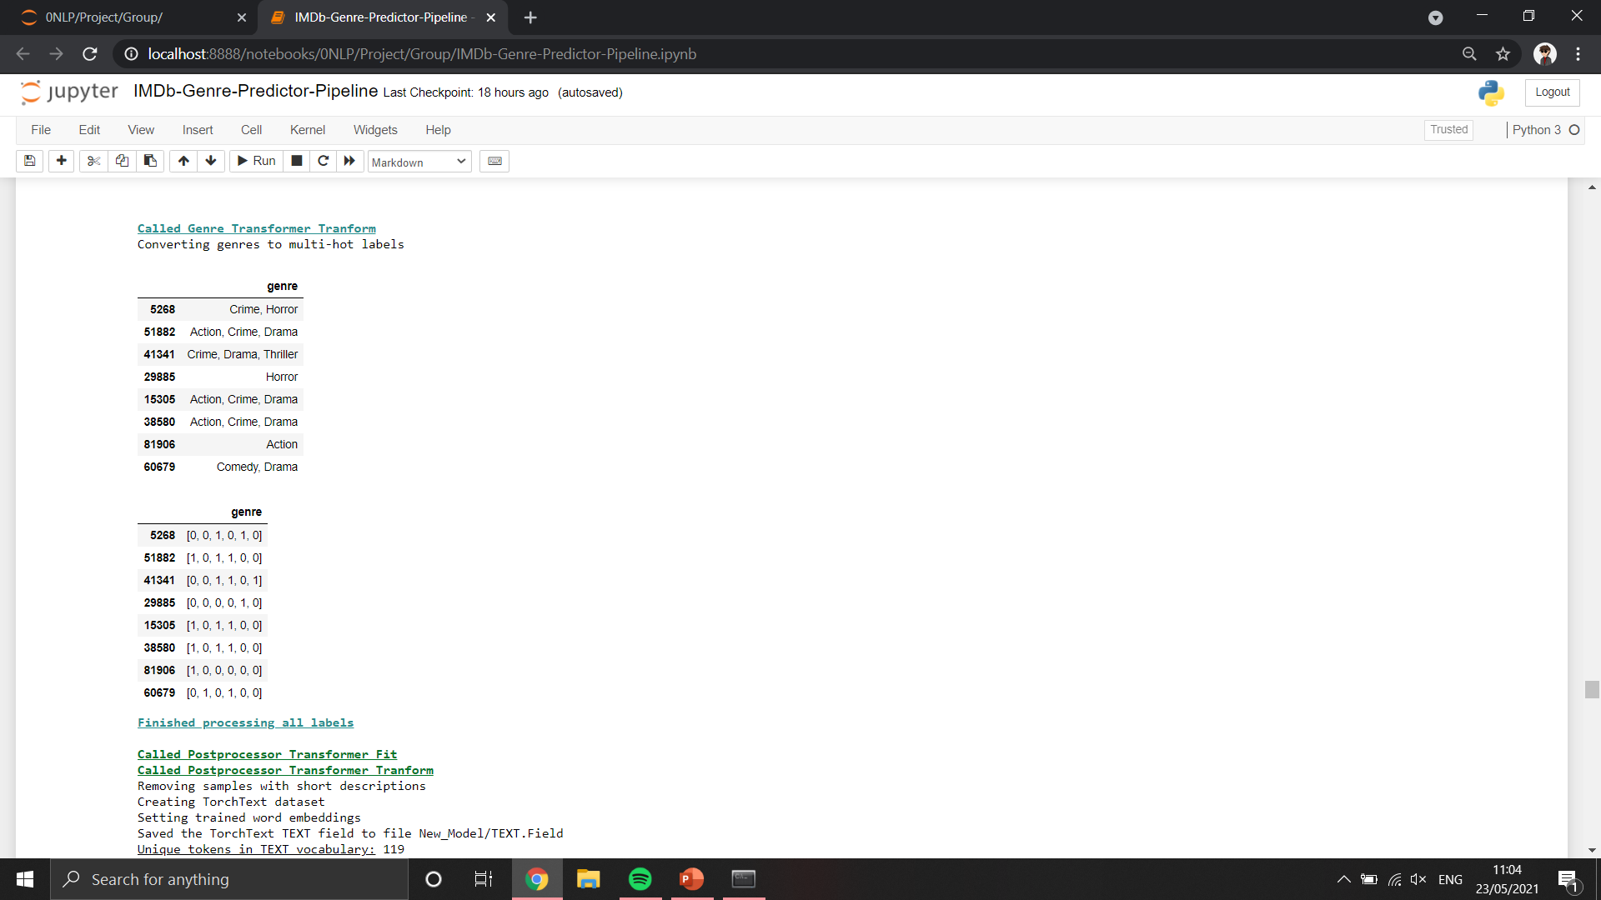
Column Transformer
The column transformer consists of two steps for processing the columns of the train / test sets:
2) The genre transformer converts the genre column to a form suitable for classifier training
Each list of genres is converted to a multi-hot binary representation
The MultiLabelBinarizer is saved to file to be used again by the web server for converting model predictions to genres
Group 10 - Tom

Slide 5
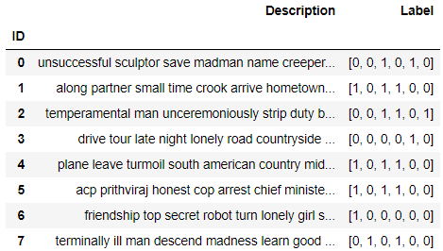
Post-processor Transformer
After calling the column transformer, columns are joined together again as a dataframe, and the post-processor transformer is called:
Unsuitable samples are dropped that do not contain a minimum number of words due to stop word removal
TorchText fields are constructed, and the data converted into a TorchText dataset so that the model knows how to handle each part of the data
Some model parameters are returned such as the vocabulary size, number of classes, GloVe pre-trained word embeddings and padding and unknown token indexes
Group 10 - Tom

Slide 6
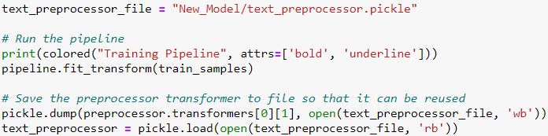
Model Transformer
The final step is the model transformer.
Calling fit_transform on the pipeline with training data will:
Split processed data into training and validation sets using k-fold cross validation
Batch the data
Create and train a new model
Group 10 - Tom

Slide 7
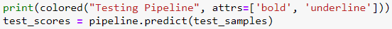
Model Transformer
The final step is the model transformer.
Calling predict on the pipeline with testing data will:
Load the classifier from file
Batch the processed test data
Test the model and return results
Group 10 - Tom

Slide 8
Selecting the Best Model Architecture
To select the architecture to deploy, we compared models from the individual coursework.
Across the group, we covered: CNN, LSTM, transformers, SVM and One-vs-Rest classifiers.
LSTM and transformer worked best with word embeddings so were compared further.
Using the same test data and pre-processing, the transformer got 23.8% test accuracy, compared to the LSTM’s 27%.
Therefore, the LSTM was selected to include in the pipeline.
Group 10 - Alex
Notes:
Can add more to this slide if you want

Slide 9
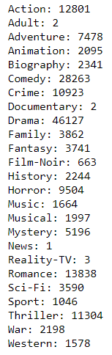
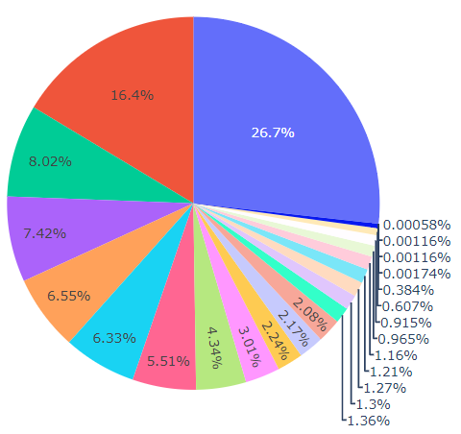
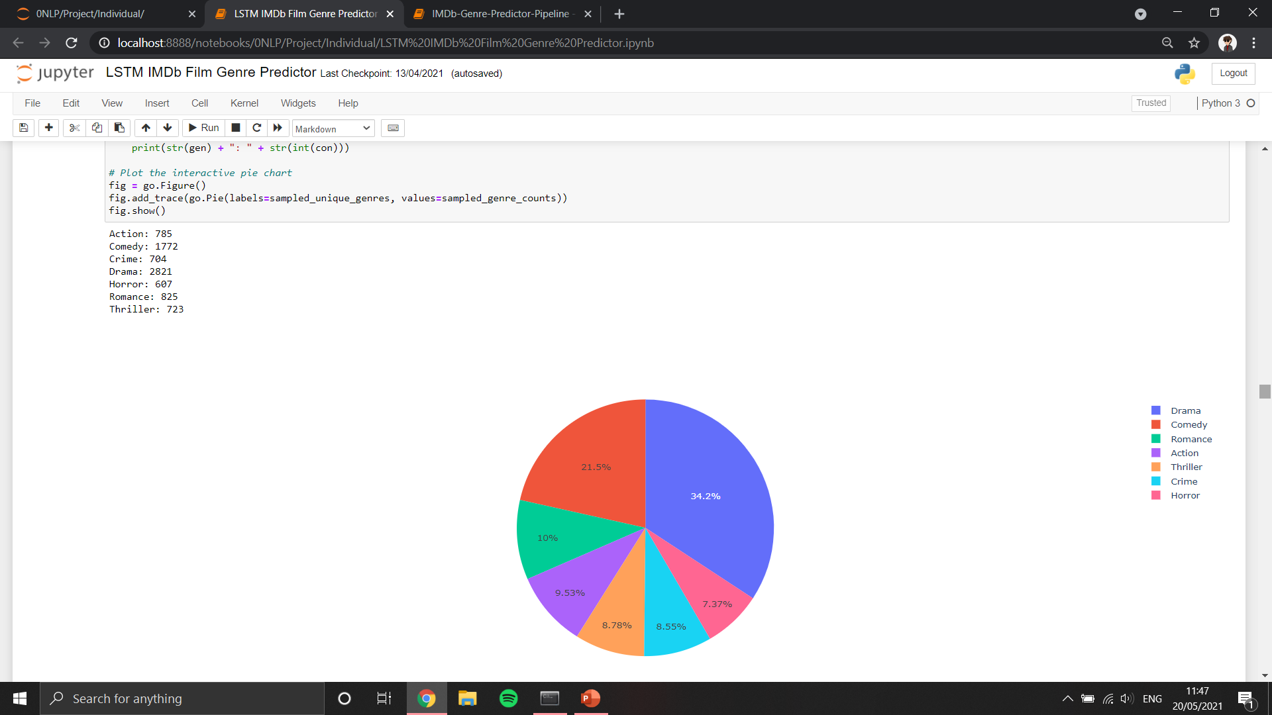
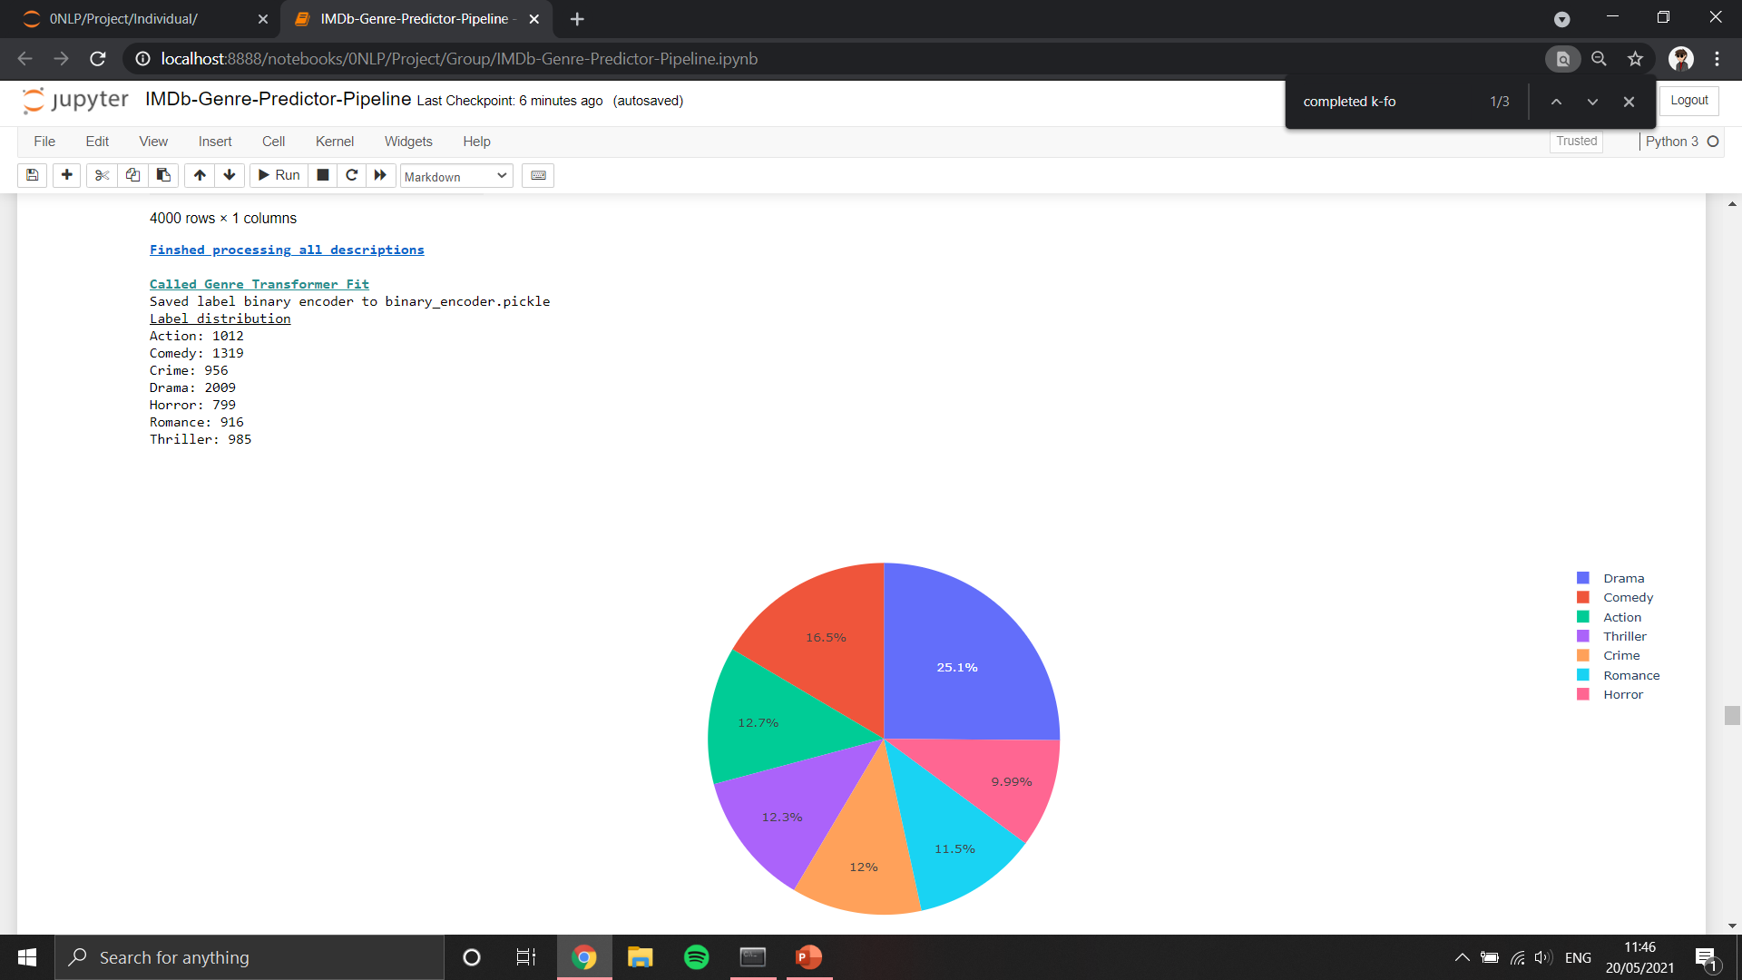
Sample Distribution
An issue we discovered were that not all genres have many samples and so some sample had to be removed.
However, this still left a bad distribution that caused the model to be good at predicting the most common genres drama and comedy, but rarely predicting rarer ones such as romance or crime.
Group 10 - Alex
Notes:
Talk about how samples were unbalanced with their labels and how this was a problem.

Slide 10
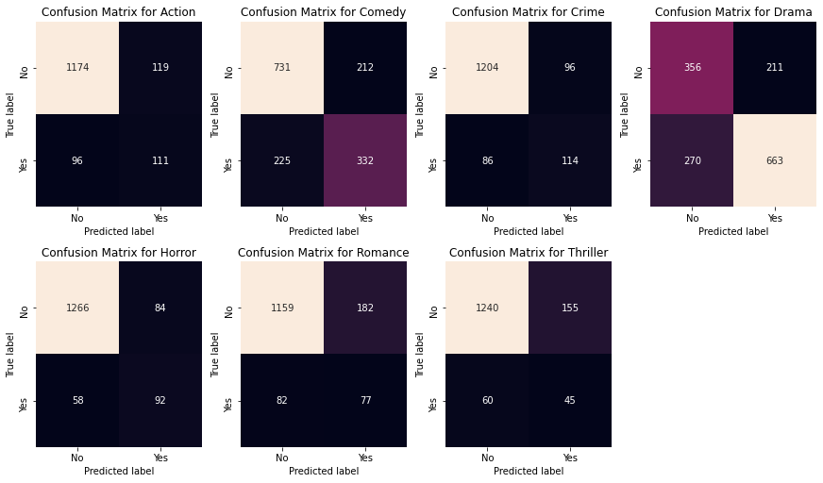
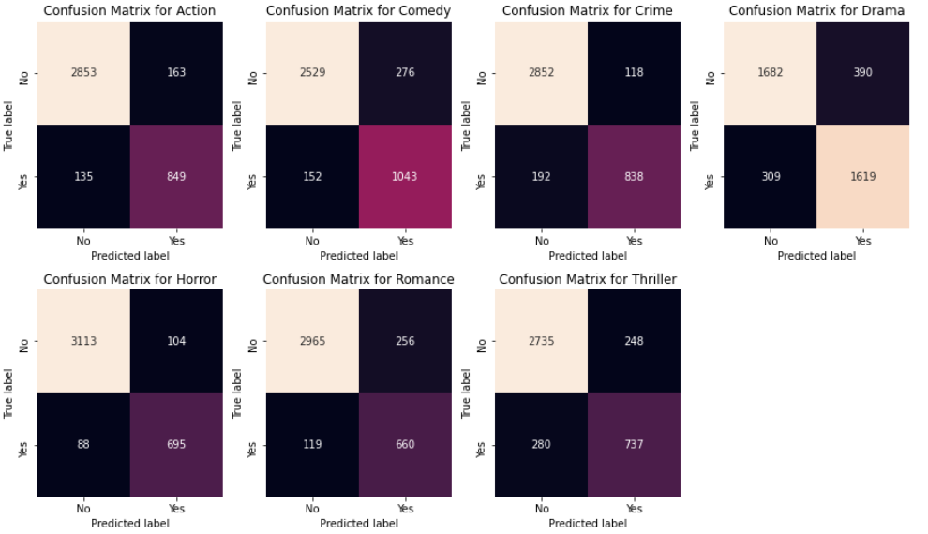
LSTM Optimisation
The selected architecture was a bidirectional LSTM with:
120 hidden layers
70% dropout
Sigmoid activation
Adding a batch normalization layer made a large improvement.
Max Epochs | Batch Size | Batch Norm | F1 | Test Accuracy
50 | 32 | No | 0.597 | 27.2%
50 | 32 | Yes | 0.818 | 57.0%
Group 10 - Alex
Notes:
Talk about how the parameters of the selected model were optimized. Without batch normalization, the model was only good at predicting the same genres. With batch normalization, the model was able to confidently predict each type of genre.

Slide 11
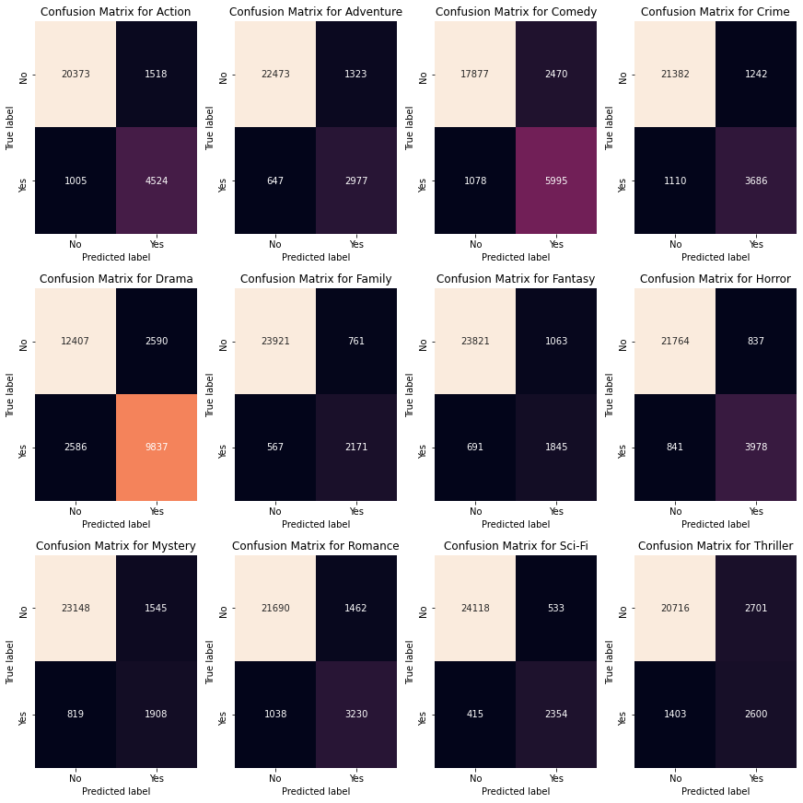
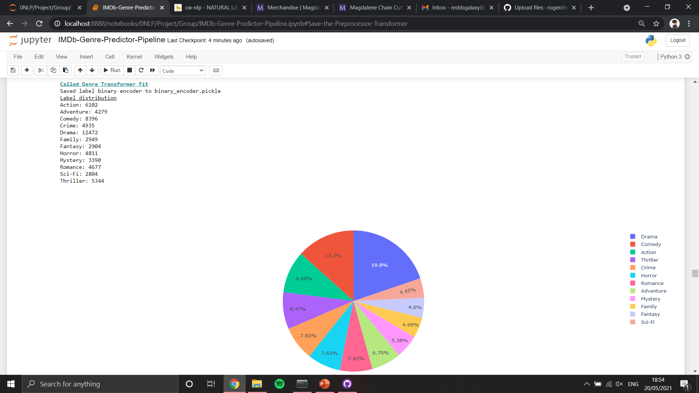
LSTM Optimisation
The model was then trained twice with more genres and samples tested with two batch sizes.
The best model achieved 40.1% test accuracy and the state was saved to file to host on the web application.
Max Epochs | Batch Size | Batch Normalization | F1 | Test Accuracy
50 | 32 | Yes | 0.747 | 40.1%
50 | 16 | Yes | 0.74 | 38.7%
Group 10 - Alex
Notes:
Batch sizes 32 and 16 were compared, 32 was better. The state of this model was saved to file.

Slide 12
Model Serving Options
Flask is written in Python
Tornado
Pyramid
Django
Group 10 - Lavinia

Slide 13
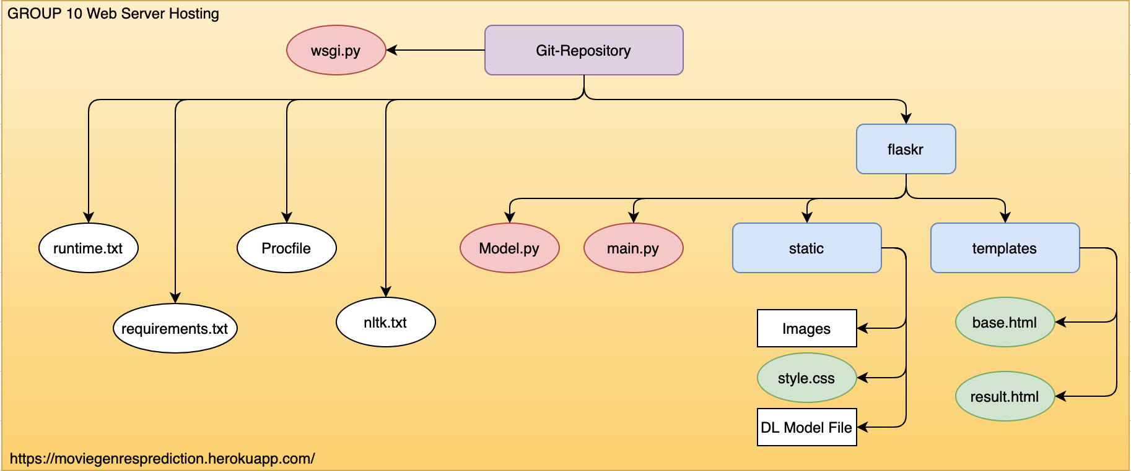
Web Service Hosting
Flask Web Framework
Group 10 - Roger

Slide 14
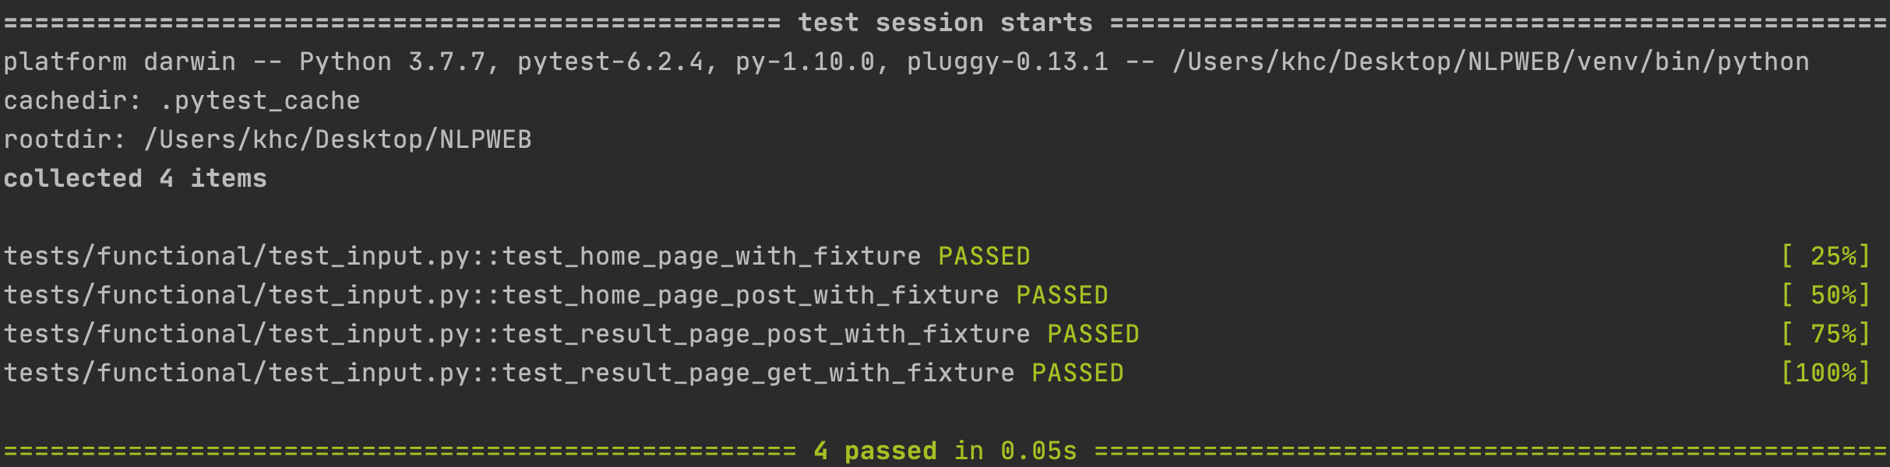
Endpoint Testing
Functional Test
Home page and Result page
Group 10 - Roger

Slide 15
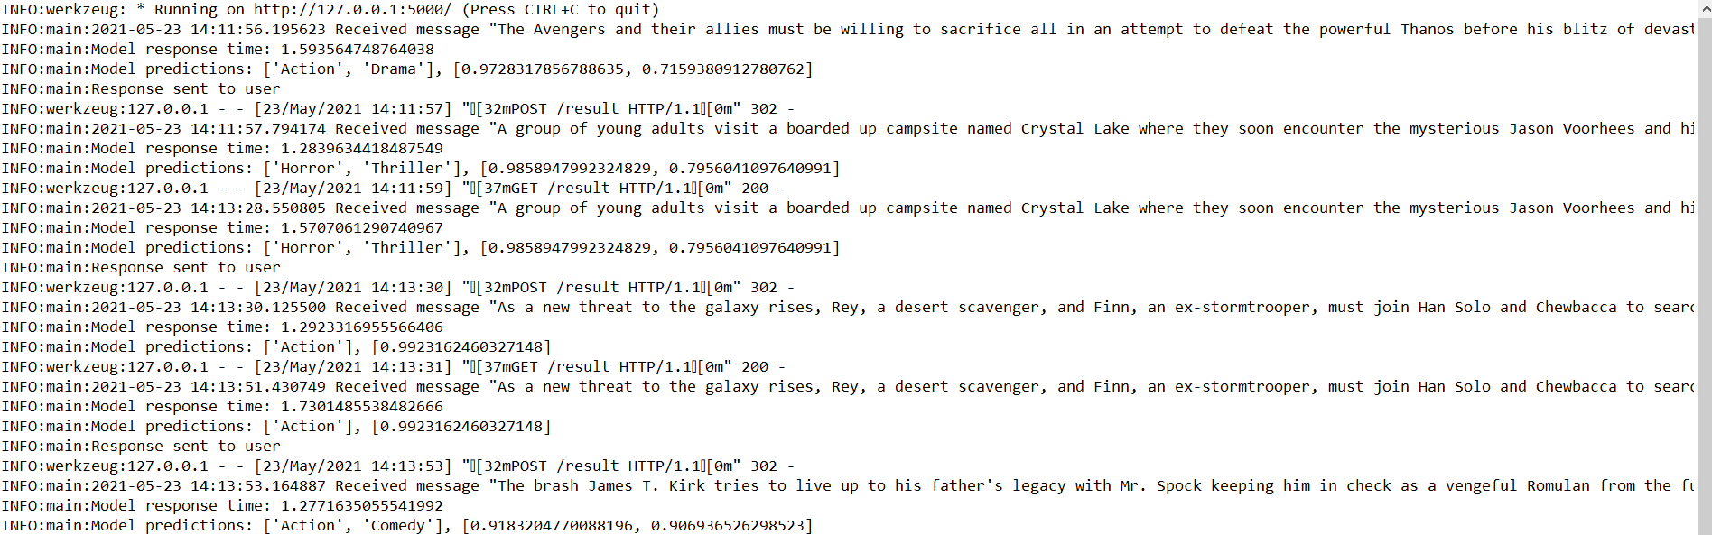
Input and Prediction monitoring
When a user input is given, the text is saved to a log file NLPWEB.log along with a time-stamp.
The model’s response time is recorded as well as the predicted genres and percentage confidence.
The logger also documents the HTTP method and whether the server sent the prediction to the user.
Group 10 - Roger

Slide 16
Service Performance
Good points
We successfully implemented a multi-label classifier that can predict between one to three genres
The deployed model test accuracy is reasonably high at 41%
The web server takes a user input and returns both the predicted genres and confidence probability
The model returns high confidence probabilities for obvious genres
The web server model response time is reasonably fast at about 1.5 seconds
The web application design is responsive
The pipeline and web application have been designed for future expansion
The pipeline is successful at training and deploying a new model
Testing is built into the pipeline and web application
Version control was used through uploading source code and trained model states to GitHub
Group 10 - Alex

Slide 17
Service Performance
Limitations
The web server can only be deployed locally as we could not deploy on Heroku because the files exceed 500 MB
We did deploy a one-vs-rest classifier instead as the model size was smaller
We could try different model serving options such as Tornado, Pyramid or Django
The model response time could be faster
The user’s inputs and model predictions could be stored to a database rather than a log file
The pipeline is slow to train as the model is complex
Functionality to train different types of models, such as CNN or SVM, could be added to the pipeline
The model could be extended to include more genres, but more labelled samples would be required
The deployed model’s accuracy could be improved through hyperparameter optimisation
It is hard to make the label distribution even when using samples with multiple labels
Functionality could be added to deal to spelling mistakes
In the future, functionality could be included that will detect a concept drift
Group 10 - Alex

